Slide 1
Reasons that the Social Sciences are difficult, and less simple than the Physical Sciences (Thereby giving the illusion that the Phys Sci. are more effective, and the Social Sciences are “soft.”)

Slide 2
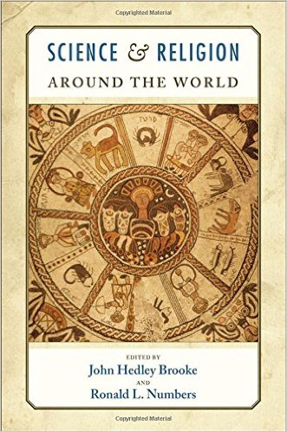
Science & Religion
need a definition of terms
What is “science”?
What is “religion” ?

Slide 3
Science is…
Behaviour
Discourse
What scientists do (and say that they do)….
Obviously begs Q: Who is a “scientist”?
The social institution that is given the function of producing true knowledge about reality
Remember Dr Harink reacted against this?
A socio-cultural practice….
Without a sense of science done by people, we expect idealizations of “science” to be actual practice
& when scientists act as persons, it casts aspersions on “science” – EXAMPLE: “ClimateGate”

Slide 4
https://www.google.ca/search?q=climategate&source=lnms&tbm=isch&sa=X&ved=0ahUKEwi_-MfYtbvRAhWIgVQKHbwFCqAQ_AUICigD&biw=1252&bih=581

Slide 5
Science & Religion
need a definition of terms
HOW do we study the S & R?
TEMPLETON $$ dominates the field
(Physicists & Evolutionary Biologists talk to Theologians
+ philosophers, historians
+ neurobiologists
Not – sociologists, psychologists, geographers,
NOT – ecological biology
NO TOPICS on ENVIRONMENT
Conflict thesis?

Slide 6
News cycle: October 28-Nov 2, 2014

Slide 7
News cycle: October 28-Nov 2, 2014

Slide 8
News cycle: October 28-Nov 2, 2014

Slide 9
News cycle: October 28-Nov 2, 2014
FACT: 1950 papal encyclical Humani generis:
Evolution isn’t a problem for Cht faith & theology

Slide 10
Sci & Relig – at odds?
Discourse ONE:
“A majority of Americans see religion and science as frequently at odds, but two-thirds of Americans say their own personal beliefs do not conflict with science, according to anew survey conducted by the Pew Research Center.”
But other people’s beliefs do conflict….
Discourse TWO:
“First worldwide survey of religion and - science: No, not all scientists are atheists” – phys.org
“Elaine Ecklund is still pretending that science and religion are compatible” (blog: whyevolutionistrue)
Notes:
Discourse ONE:
“A majority of Americans see religion and science as frequently at odds, but two-thirds of Americans say their own personal beliefs do not conflict with science, according to anew survey conducted by the Pew Research Center.”
Pew: “Highly religious Americans are less likely than others to see conflict between faith and science.” - PEW
“Secular People More Likely to See Science and Religion in Conflict” –livescience.com / Christianity Today
Discourse TWO:
“First worldwide survey of religion and - science: No, not all scientists are atheists” – phys.org
“Elaine Ecklund is still pretending that science and religion are compatible” (blog: whyevolutionistrue)
Refs for above…
““Secular People More Likely to See Science and Religion in Conflict” - http://www.livescience.com/52561-religion-science-in-conflict-survey.html
http://www.pewinternet.org/2015/10/22/science-and-religion/
http://www.christiantoday.com/article/more.non.religious.people.believe.in.conflict.between.faith.and.science.than.religious.people.pew.survey.shows/68465.htm
More non-religious people believe in conflict between faith and science than religious people, Pew survey shows
http://phys.org/news/2015-12-worldwide-survey-religion-science-scientists.html
https://whyevolutionistrue.wordpress.com/2014/02/18/elaine-ecklund-is-still-pretending-that-science-and-religion-are-compatible/

Slide 11
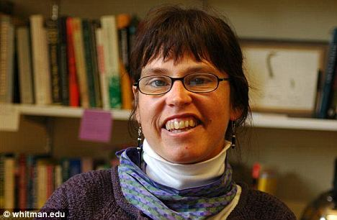
Paper presented “Climate Change and Cultural Inertia: London (UK), March 2012
Kari Marie Norgaard, University of Oregon, USA
Robert J. Brulle, Drexel University, USA
Randolph Haluza-DeLay, The Kings University College, Canada

Slide 14
Reasons that the Social Sciences are difficult, and less simple than the Physical Sciences (Thereby giving the illusion that the Phys Sci. are more effective, and the Social Sciences are “soft.”)

Slide 15
Sociology is:
The systematic (scientific) study of SOCIAL relations
Being a SCIENCE, sociology relies on METHODS to collect DATA, and EXPLAIN (concepts, theories).
Persons relate to other persons at all levels
1 to 1
Small group (intersubjective)
Larger groups (but still ‘personal’)
Institutions, communities, countries
Globally

Slide 16
A sociologist is a prophet Reporting Questioning Debunking often Challenges the status quo (because of data collection) a sociologist describes WHAT IS, rather than what we WISH it is, in order to make us think what it SHOULD be (or we WANT to be.)

Slide 17
Sociology of Science
“Internal” orientation:
Reports what “science” IS, for example:
what scientists do?
what are their “norms”?
What do people called “scientists” call legit “science”?
how does power (e.g., $, status) operate?
how is “knowledge” produced?
what is obscured?
“External” orientation
Questions interaction of “things that are part of ‘science’” with other parts of that society, for example:
how does the media report on various sciences (medicine, astronomy, ecology, sociology, paranormal phenomena)?
what do various types of people consider legit science?
who funds scientific research and how does that shape what we know and what we don’t know?
Mindset
Debunks common sense” (“how did what seems to “make sense” come to be commonly held”?) - skepticism
“Sciences” give “true” picture of the world?
Listen to “science” and we will do the “right thing” vis a vis climatechangeabortioncancerfemale hormonesracialgroups….
http://www.cbc.ca/radio/ideas/how-to-think-about-science-part-1-24-1.2953274
http://www.cbc.ca/radio/ideas/science-under-siege-part-1-1.3091552

Slide 18
The Sociology of Science? (sociologist as debunker)
Strong reaction against the social scientific study of “science” (e.g., the “science wars”) because,
“part of the myth of science is that its methods and the knowledge produced through their application are beyond scrutiny and untainted by subjectivity…” (Stahl, et al., p. 32)

Slide 19
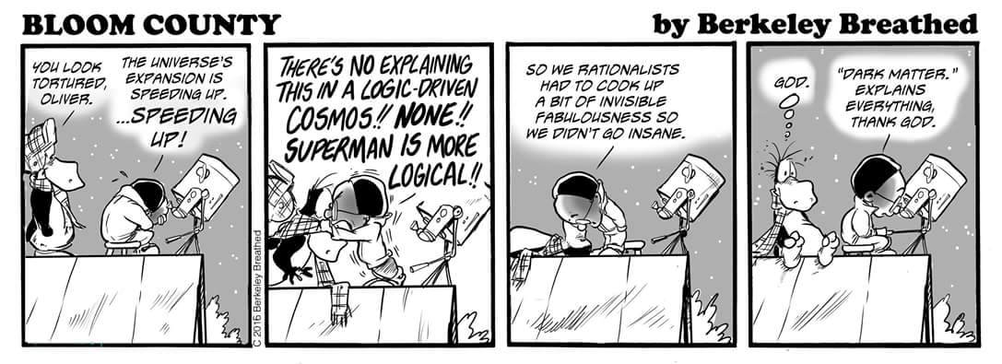
Science as the “knowledge authorities”
The “priests” of modernity
The Sacred Myth of Modernity:
Scientific explanations are better than any other ways of perceiving or explaining the world.

Slide 20
The Sociology of Science? (sociologist as debunker)
“Scientific fields, are microcosms which in a certain respect are social worlds like others, with concentrations of power and capital, monopolies, power relations, selfish interests, conflicts, etc.,
are also, in another respect, exceptional, somewhat miraculous universes, in which the necessity of reason is instituted to varying degrees… ” (providing the illusio that science is all and only about reason)
(Bourdieu, reference missing)
CBC-How to Think about Science – 24 part series!!
http://www.cbc.ca/radio/ideas/how-to-think-about-science-part-1-24-1.2953274

Slide 21
Reasons that the Social Sciences are difficult, and less simple than the Physical Sciences (Thereby giving the illusion that the Phys Sci. are more effective, and the Social Sciences are “soft.”)
Humans and their relations are incredibly complex.
AND, some of what we study is not “present to the senses”, e.g., love, values, inequality, poverty (poverty?) , money (money?), “race” , etc.
we have to “construct” our concepts of these things.
We have to imagine how to measure, examine these things,
DATA shows income differences based on a very many set of factors – we call this “class” (and different collections of the factors are different concepts of class and different explanations (theories) of class formation in complex societies.
Try to write a formula for the circulation of power in political-economic systems (too many variables, with too much variability, and few meaningful constants).
Humans are able to decide what to do (agency)– we, don’t blindingly follow “laws.”
Social Scientists are part of that which they study (so “objective” is more nuanced).

Slide 22
What Sociological tools to understand “the environment”?
PARTNERS
An orderly and organized expression of thought on a
subject, using vocabulary and style of communication that tends to provide the boundaries of what can be
← said about a subject.
Ideas
Discourses
Norms
Practices
Statuses
Roles
Groups
Institutions
Structures
Cultures
Power
← Norms are “a standard or pattern, especially of social behavior, that is typical or expected of a group”
← Practices are regularized actions and behaviour done by individuals or institutions
* materials * meanings
* Competencies *provisions
“set of organized beliefs and rules that are the societal
← form by which basic needs are met”
←“Patterns of social relationships in a society”

Slide 23
Plausible (to public): Truth (social scientifically): | Plausible to observer | NOT plausible to observer
Research shows “true” | no duh! (Labouring the obvious) | Charletan! (Claiming knowledge that is ‘obviously’ false)
Research shows “not true” | No Way! (Heretic) | No Duh! (What a fool, wasting $)

